Slide 2
One team = one international team = 1 student from HU, 1 from CZ, 1 from …
Please put your names on paper with teams color.
Each team work on own IoT tower
BLACK TEAM
RED TEAM
BLUE TEAM
ORANGE TEAM
GREEN TEAM

Slide 3
READY?
A bit theory

Slide 4
What is IoT?
Internet = exchange of everything (files, images, video)
between people
IoT = exchange of small amount of data (temperature)
between things (from sensors to actuators), not people.
PC
Thing
Thing
PC
Thing
PC
Thing
Thing
PC

Slide 5
How are data transferred?
Radio 868 MHz
(licence free)
To 500 m between core modules and radio dongle
By means of radio IoT infrastructure (Sigfox, LoRa) everywhere on the earth
Battery supply
(1-2 years)
Radio 2.4 GHz (5GHz)
(licence free)
Wifi, bluetooth
High power consumption
Short distance (max 100 m)
Worse penetration through the walls
230 V with adapter supply
(1-2 years)

Slide 6
BATTERY OPERATION
IS THE BEST
Can you imagine humidity sensor far
in the field with accumulator similar to Tesla car
or 5 km long power supply?

Slide 7
ARDUINO?
No, because its power consumption is high.
It must function with 230 V to 5 V adapter (5 V DC power supply).
(it uses microcontrollers ATMega
from Atmel company)
ARM Processor?
Yes. 3.3 V power supply, designed for as lower as possible
power consumption.
(we use microcontroller STM 32 from company STMicroelectronics).
Flash memory from program is 192 kB, RAM is 20 kB.

Slide 8
What you have on the desk?
PC with Intel i5 and 8 GB RAM
Mounted IoT tower. It displays what it displays.
Lithium battery pack
USB to micro USB data cabel for transferring data from PC to IoT tower
Radio dongle for communication between IoT tower and PC
What is installed on PC?
IDE Visual Studio Code latest version with extension PlatformIO for
programming IoT tower in C language
2. IDE Microsoft Visual Studio for Communities latest version for programming
mobile application for displaying data on smart phone with Android (unfortunately IOS need 5 days
approvement)
Hardwario Playground for displaying data from sensors on PC by means of radio on core modul
(there is implemented MQTT broker Mosquito and graphic tool node – red).
You do not need more!

Slide 9
Enough theory. Lets work.
Our first task:
Each of you demount and mount nodes of IoT tower

Slide 10
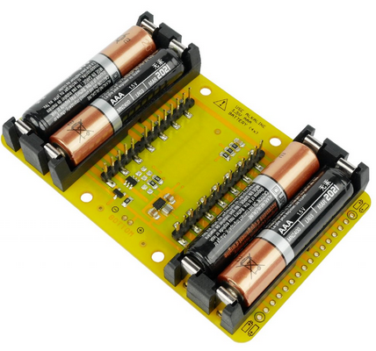
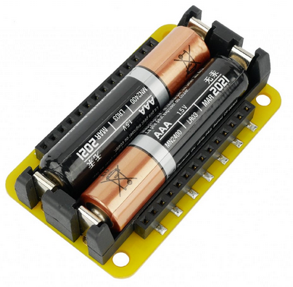
Battery modul
4 x 1.5 V

Slide 11
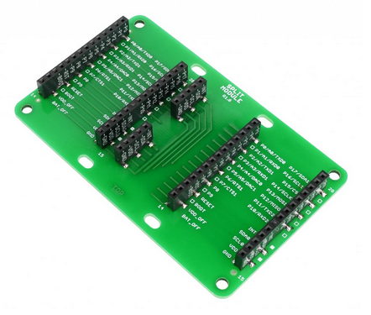
Split module
Split tower to two towers

Slide 12
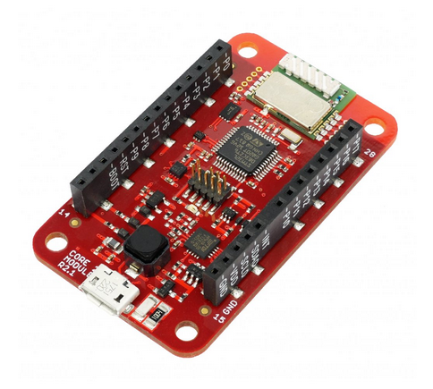
Core modul:
32 bits ARM microcontroller STM32
192 kB Flash memory
20 kB RAM
868 MHz radio receiver/transmitter
Integrated thermometer
Integrated accelerometer
Inputs / outputs:
18 x GPIO
Serial communication:
SPI
UART
I2C
1 wire
ADC and DAC

Slide 13
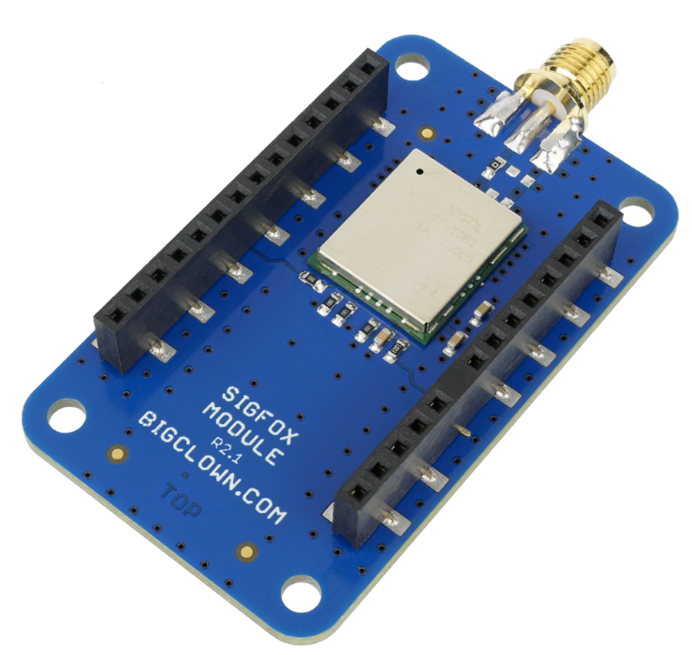
Sigfox modul
With antenna
For communication (sending messages) with server in France
Now not in offer, because a problem with sending data
when supply voltage decrease.
We have the best Lithium battery, so it could not be a problem.

Slide 14
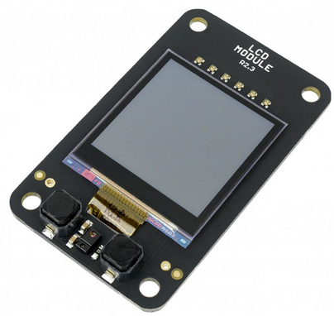
LCD modul
128 x 128 px
Ultra low power consumption
2 buttons
7 LEDs

Slide 15
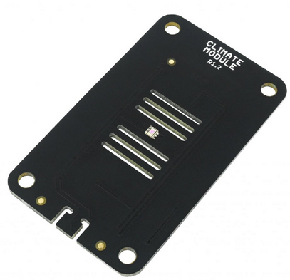
Climate module
Temperature sensor
Relative humidity sensor
Atmospheric pressure sensor
Light intensity sensor

Slide 16
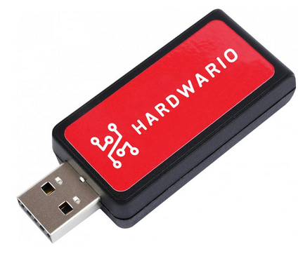
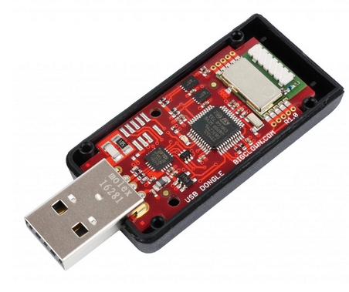
Radio dongle
Implemented radio 868 MHz for communication with IoT towers
PC

Slide 17
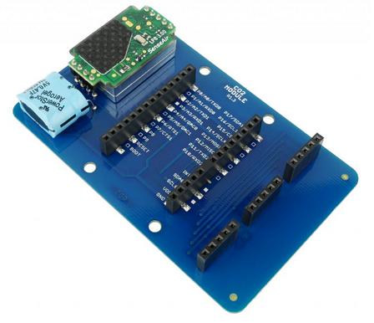
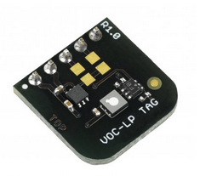
These components are not included at our tower
CO2 modul for measurincg CO2 concentration
VOC modul for measuring amount of dust in the air

Slide 18
More information on hardwario.com

Slide 19
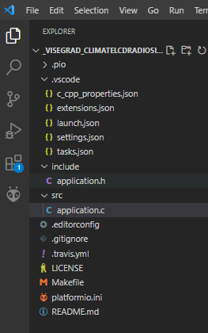
Enough images. Lets programming.
Our second task: programming IoT tower in C language
Why C? Reliable, well known, for IoT excellent.
PLEASE PUT ALL CODE TO VISEGRADPROJECT DIRECTORY ON DESKTOP
Connect tower with USB on PC.
Download file _Visegrad_ClimateLCDRadioSigfox.zip from sostn.info/Visegrad/Outputs
Unzip it to directory Visegrad on your desktop
Start Visual Studio Code
Click File / Open folder – find directory _Visegrad… - Select folder
Open file application.c in dir src and application.h in dir include – there is ou source code
Build project (build = translate source to binary)
Upload project (binary is uploaded to Flash memory of core modul)
Now we explain source code and make some changes.
Build
Upload

Slide 20
1 Byte for temperature value
1 bit
Byte [B]
bit [b]
1B
1 bit is basic unit for information description.
It can content only one of two numbers – 0 or 1.
Why computers work with bits?
Because they work with data. Data must be stored.
Only one electrotechnical component can store data
capacitor. It can be charged (log. 1) or not charged (log. 0). There is nothing between.
8 bitov
1 Byte
1B
256 various combitations of 0 and 1
Number of variations = 2 = 2 = 256
number of bits bit
8

Slide 21
1st Byte is for temperature value (only 1B is for temperature)
Q1 = which range?
Q2 = which accuracy?
Mantinel 1: Temperature sensor:
Range: -40° C to 125° C (datasheet)
Accuracy: cca 0.0625° C (datasheet)
Problem: accuracy of sensor measurement is 0.06° C.
Our accuracy is 0.5° C.
BUT: for our task it is OK.
IF NOT: we must use for temperature 2 B.
2B = 256 x 256 = 65 000 various values = cca 0,001° C accuracy
Mantinel 2: CPU operating temperature:
Range: -20 to 70° C (datasheet)
Math is in application.h file
Why?
Absolutely it is 128 integer values (-40, -39, -38 …)
-40
0
125
-40
21.0 21.5 22.0
88
Our decision:
Range of measuring: -40 to 88° C
Measured: 22.623354
0.5° round: 22.5 decimal
Converting: AF hexadecimal
Sending to Sigfox: AF
REAL > DEC > BINARY > HEXA
-40.0 > 0 > 0000 0000 > 00
-39.5 > 1 > 0000 0001 > 01
-39.0 > 2 > 0000 0010 > 10
21.0 > 42 > 0110 1101 > A6
21.5 > 43 >0110 1110 > A7
87.5 > 255 > 1111 1110 > FE
88.0 > 256 > 1111 1111 > FF
BUT we have 256 values in 1 B.
Result: each degree will be devided to two halfs.
-40, -39.5, -39, -38.5 … 87, 87.5, 88 – together 256 values
We used 1 Byte for temperature.
Measured: 22.7623354
0.5° round: 23.0 decimal
Converting: BF hexadecimal
Sending to Sigfox: BF

Slide 22
2nd Byte is for humidity (only 1B)
Q1 = which range?
Q2 = which accuracy?
Mantinel 1: Humidity sensor:
Range: 0 % to 100 %
Accuracy: ±2 %
Normal humidity for human is
50 – 60 %.
In the cloud = 100 %
0,5 kPa
Math is in application.h file
Mantinel 2: CPU no limitations
0
100
We need 1 B = 256 various values.
Step will be 0.5 %
0, 0.5, 1, … 99.5, 100
BUT we have 256 values in 1 B.
Result: 56 binary values will not be used. But it is OK, humidity can not be 120 %.
REAL > DEC > BINARY > HEXA
0 > 0 > 0000 0000 > 00
0.5 > 1 > 1 > 0001 > 01
1 > 2 > 0010 > 10
100 > 200 > 1001 > d2

Slide 23
3rd Byte is for atmospheric pressure (only 1B)
Q1 = which range?
Q2 = which accuracy?
Mantinel 1: Pressure sensor:
Range: 20 kPa to 110 kPa
Accuracy: 0.4 kPa
Normal pressure at sea level is
1 Atm (Atmosphere) = 101 325 Pa
1 Atm = 760 torr (old unit)
It depends: elevation above the sea, temperature and weight of air (dry or wet)
Trencin: normal is 988 (988 hPa)
0,5 kPa
Math is in application.h file
20 000
110 000
BUT we have 256 values in 1 B.
Result: each degree will be devided to two halfs.
20 000, 20 500, 21 000,… 110 000 together 180 values
We used 1 Byte for temperature but we do not use it all.
REAL > DEC > BINARY > HEXA
20 000 > 0 > 0000 0000 > 00
21 000 > 1 > 0000 0001 > 01
22 000 > 2 > 0000 0010 > 10
110 000 > 90 > 0110 1101 > d2
Mantinel 2: CPU no limitations
Why?
Absolutely it is 90 = 110 - 20 integer values (20 000, 21 000 …110 000)

Slide 24
4th and 5th Byte is for light intensity (2B)
Q1 = which range?
Q2 = which accuracy?
Mantinel 1: Light sensor:
Range: 0.01 to 83 000 lux
Accuracy: cca 0.001 lux
EU says: 300 lx at classroom, 500 lx near the blackboard
Sunny day: 100 000 lx
Sunny day in shadow: 10 000 kx
Street at night with lamps: 10 lx
Night with full moon: 0.25 lx
Night with stars: 0.001 lx
0,5 kPa
Lumen = amount
of light energy
from light source
Less light?
Go more near to light source
or
buy source with more lumens
Math is in application.h file
Bulb
Lux meter
= Illuminance sensor
Working table
65 536 83 000
0
We need 2 Bytes.
REAL > DEC > BINARY > HEXA
Why?
1 B = 256 various values. It is too small for range 0 – 100 000 lux (step 390 lux is very high)
2 B = 65 536 various values. Step is 1 lux = OK.
Problem:
If light will be from 65 536 to 83 000 lux, on database will be saved only 65 536 lux. But it is OK.
0 > 0 > 0000 0000 0000 0000> 0000
1 > 1 > 0000 0000 0000 0001 > 0001
65 536 > 65 536 >
1111 1111 1111 1111 > FFFF
83 000 > 65 536 >
1111 1111 1111 1111 > FFFF

Slide 25
6th battery voltage 7th battery charge (1B, 1B)
Sumilar to others
Math is in application.h file

Slide 26
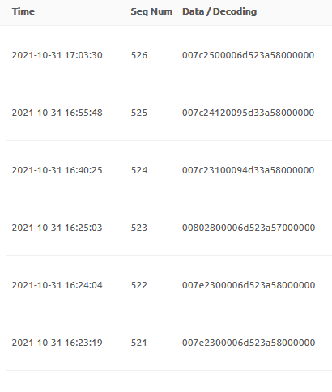
SIGFOX Payload
Sending data from sensors to Sigfox database server somewhere in France.
Saving data to server is payable service. Slovak company SimpleCell Slovakia gave
our school free account for 100 Sigfox modules.
Each team has own account. See sostn.info/Visegrad
Where? backend.sigfox.com
We see data – so called payload in 12 B in hexadecimal code
ff
ac
51
f5
c2
a6
94
23
fc
56
2b
d8
12 B payload
CO
Temp
Hum
Light
Light
Press
Press
Volt
Charge
00
00
00

Slide 27
Conclusion:
We can send data to Sigfox.
We can send data by radio.
We can display data on LCD modul.
Our third task:
How to see data on Sigfox server (displayed in hexadecimal code!)

Slide 28
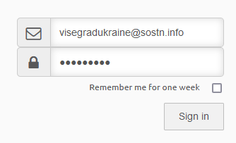
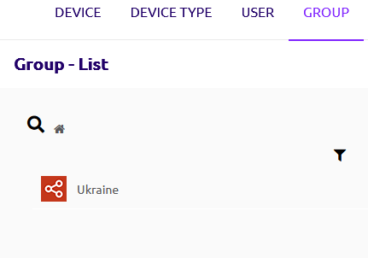
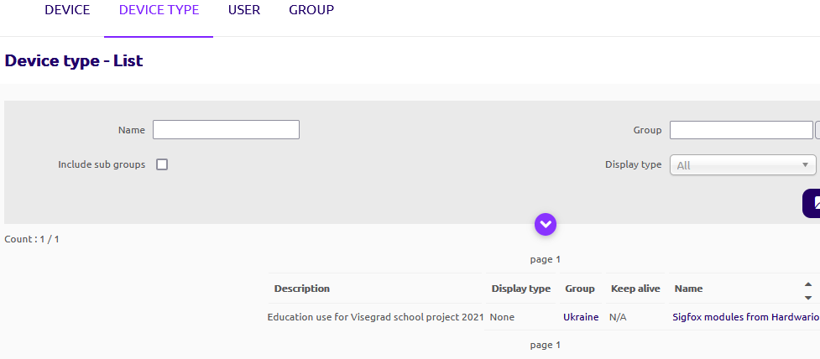
backend.sigfox.com
VisUkr21@
Each team has own account with one
registered Sigfox module. You can register
new Sigfox modules.

Slide 29
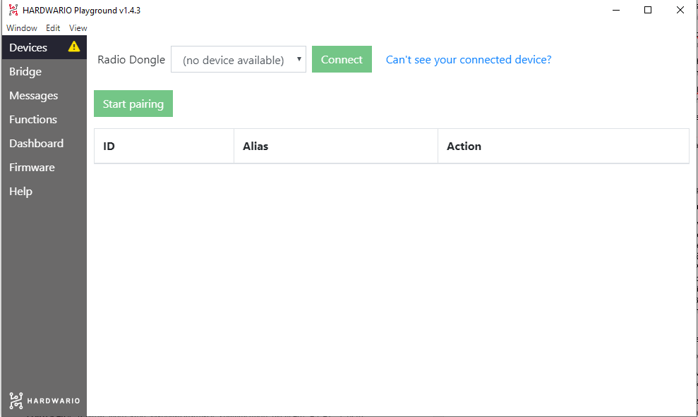
Our fourth task:
How to read data sent by radio on Core modul (not by Sigfox).
Easy:
Open Playground.
Put Radio dongle into USB.
Click Connect
Remove battery from tower
Click Start pairing
Put battery to tower
ID of tower and Visegrad will be displayed

Slide 30
Visual Studio Code
IoT Tower from hardwario.com
Microsoft Visual Studio (Xamarin)
LCD display
(values from sensors)
Sensors:
Temperature
Humidity
Air pressure
Light intensity
Programming
app for
Displaying data
in Xamarin
PC
Displaying data from sensors on monitor, wireless till 500 m
Core modul
(MCU)
antena
Climate modul
Smart phone with Android
Displaying data from sensors
antena
Sigfox modul
Battery modul
To Sigfox server wireless
Sigfox server for data from sensors saving
(in France)
Retrieving data from Sigfox database
to smart phone SQLite database

Slide 31
Our last task:
How to get data from Sigfox server to smart phone?
Solution 1: use app of third side.
Problem 1: You have to pay for this service
Problem 2: You have not app under control (you do not know source code)
We want to have things under the controll!!!
Solution 2: make your own mobile app!
What you need?
IDE for programming. One for IOS and one for Android.
But we prefer one IDE for both operating systems called XAMARIN.
It is a part of Visual Studio (during installation choose install Xamarin).
We use free Visual Studio for Communities. It is already installed on your desktops.
Download and unzip solution from http://www.sostn.info/visegrad/#Outputs

Slide 32
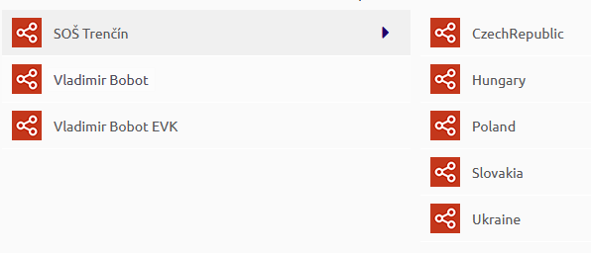
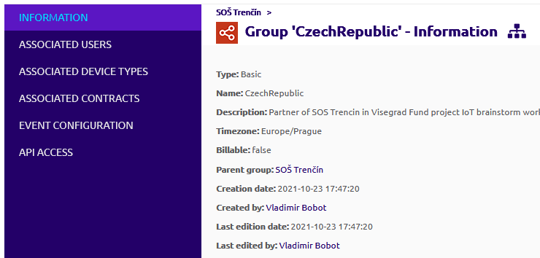
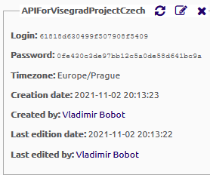
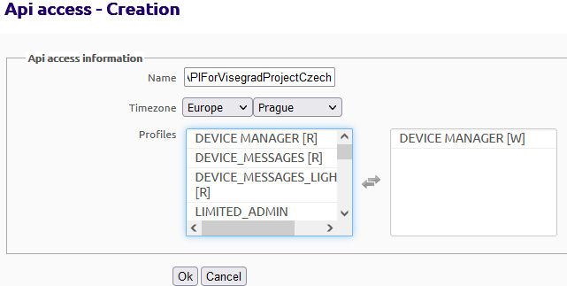
One thing for explanation:
You have to get data from Sigfox API.
You need to create it for your group as follows:
Click API access - New
This is result. You see Login and password to API. Each group will do the same.

Slide 33
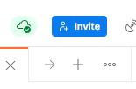
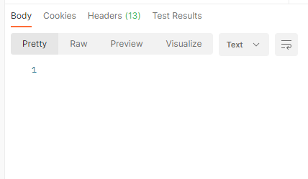
Now we try, if is access to API OK.
We use program Postman (for http requests). Pls install it.
Click +
Click Send. Use login and password from API created before. You want to get data, so HTTP request is GET.
Resuts are none, because there are still no data. Try it each group with data!

Slide 34
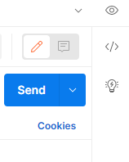
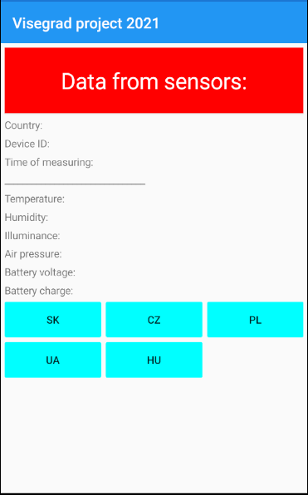
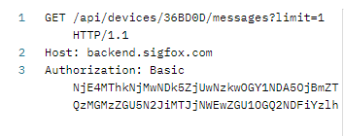
You put to Postman login and password not secret. Postman coded them. Coded data you see after click on </>.
Important: in Xamarin you use to connect to API this string:
That’s all, lets go to Xamarin. We will continue on line. Result is on the right.
Pls, each team has own code, own name. Then generating apg file
and install app on your phones. From app we will be able to see data
in each country, when you will be back at home.

